Slide 1
Welcome to Bowdoin
Martina Duncan (she/her/hers)
Registrar
registrar@bowdoin.edu

Slide 2
YOUR RECORD IN POLARIS polaris.bowdoin.edu
Personal biographical information (can be changed on the Enrollment form each semester, or the biographical change form)
Academic Profile (placements, holds, test scores)
Academic Contacts (instructors, advisors, student deans)
My Courses (current and future schedule as available)
My Grades
My Status (enrollment status and academic standing)

Slide 3
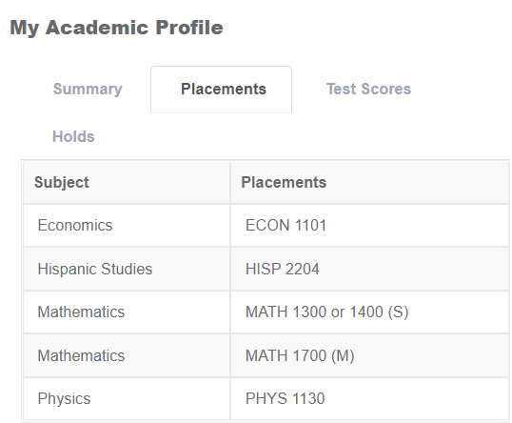
YOUR RECORD IN POLARIS: Academic Profile
Before meeting with your advisor:
Be sure all holds are cleared, except your advisor hold; you may need to contact Student Aid, the Bursar or Health Services or fill out your Enrollment Form
Take a look at your placements on Polaris under the “Placements” tab on your Academic Profile.
Neglecting any of these may result in not being able to register.

Slide 4
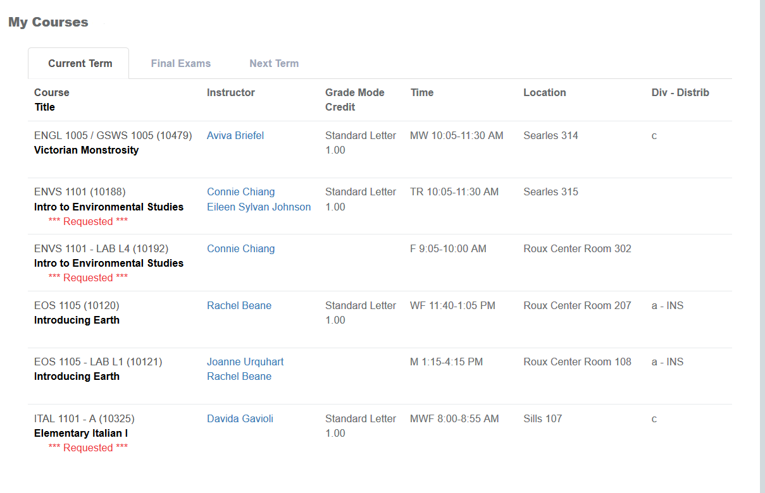
YOUR RECORD IN POLARIS: My Courses
CHECK THIS PORTAL FREQUENTLY
TO BE SURE IT REFLECTS THE SCHEDULE YOU EXPECT
It is your responsibility to add and drop courses from your schedule, including independent studies
Be sure to check it after requesting courses, and after registrations have been set

Slide 5
YOUR RECORD IN POLARIS: Additional Portals
Biographical Information
Academic Contacts (instructors, advisors, student deans)
My Grades
My Status (enrollment status and academic standing)

Slide 6
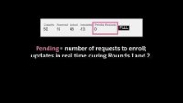
Navigating Classfinder

Slide 7
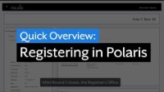
Requesting Classes – Rounds 1 & 2

Slide 8
Let’s practice!
Log into polaris.bowdoin.edu:
Find your placements
Find any holds you have
Start searching for interesting courses to make up possible schedules that will work for you!

