Slide 1
Welcome to Bowdoin
Martina Duncan, Registrar (she/her/hers)
Karen Topp, Faculty Liaison for Advising and Senior Lecturer in Physics (she/her/hers)

Slide 2
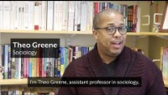

Slide 3
Considering your classes:
Choose courses that allow exploration of new areas while also investigating potential major interests
Take courses in multiple divisions of the College
(a) Natural Sci. & Math, (b) Social Sci., (c) Humanities
Spread courses across different days and time slots
Try to avoid three classes in a row
Pay attention to placement results; all placements are binding
Notes:
We're now going to return to our video to learn a little bit about choosing courses, and the registration process.

Slide 4
Don’t take too many natural science lab courses at once
For most students, this means you should take one.
Environmental Studies 1101, is not a “science lab” course, nor are Math or Computer Science. We consider science lab courses to be Biology, Chemistry, EOS and Physics.
Start early with languages
Almost all language sequences begin in the fall; small classes allow good feedback for first year students; workload is steady and spread out.
It is typical that musically inclined students take a ½ - credit ensemble and/or lessons in addition to their four standard academic courses

Slide 6
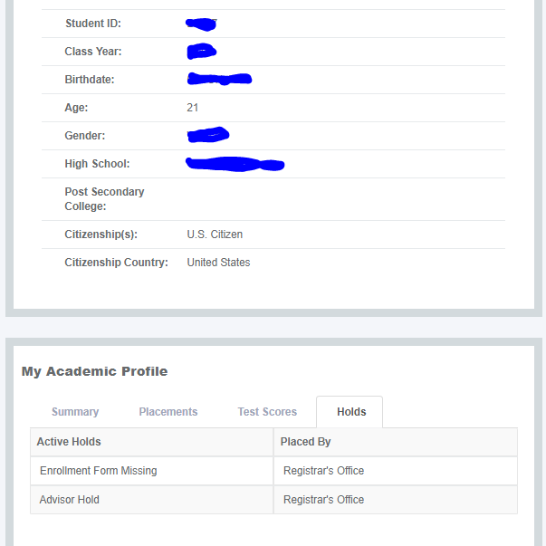
REGISTRATION The PROCESS: Holds
Before meeting with your advisor:
Be sure all holds are cleared, except your advisor hold.
Holds are listed on your student page in Polaris under the “Holds” tab on your Academic Profile, directly under your Personal Profile.
You may need to contact Student Aid, the Bursar or Health Services or fill out your Enrollment Form.
Neglecting any of these may result in not being able to register.

Slide 7
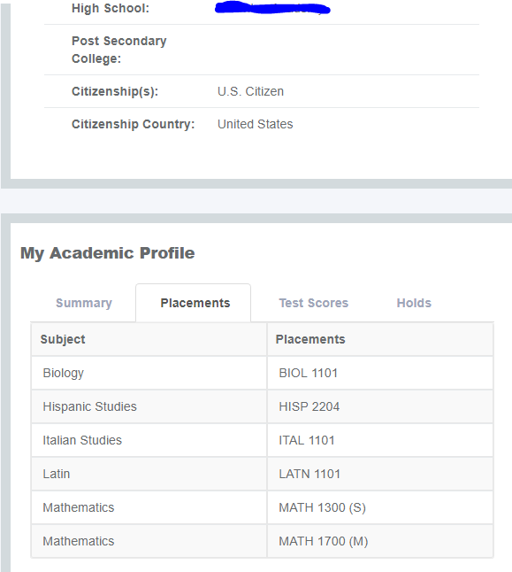
REGISTRATION The PROCESS: Placements
Before meeting with your advisor:
Take a look at your Placements on Polaris under the “Placements” tab on your Academic Profile.
Making sure you understand where you need to start in the curriculum is imperative.

Slide 8
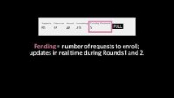
REGISTRATION The PROCESS: Classfinder

Slide 9
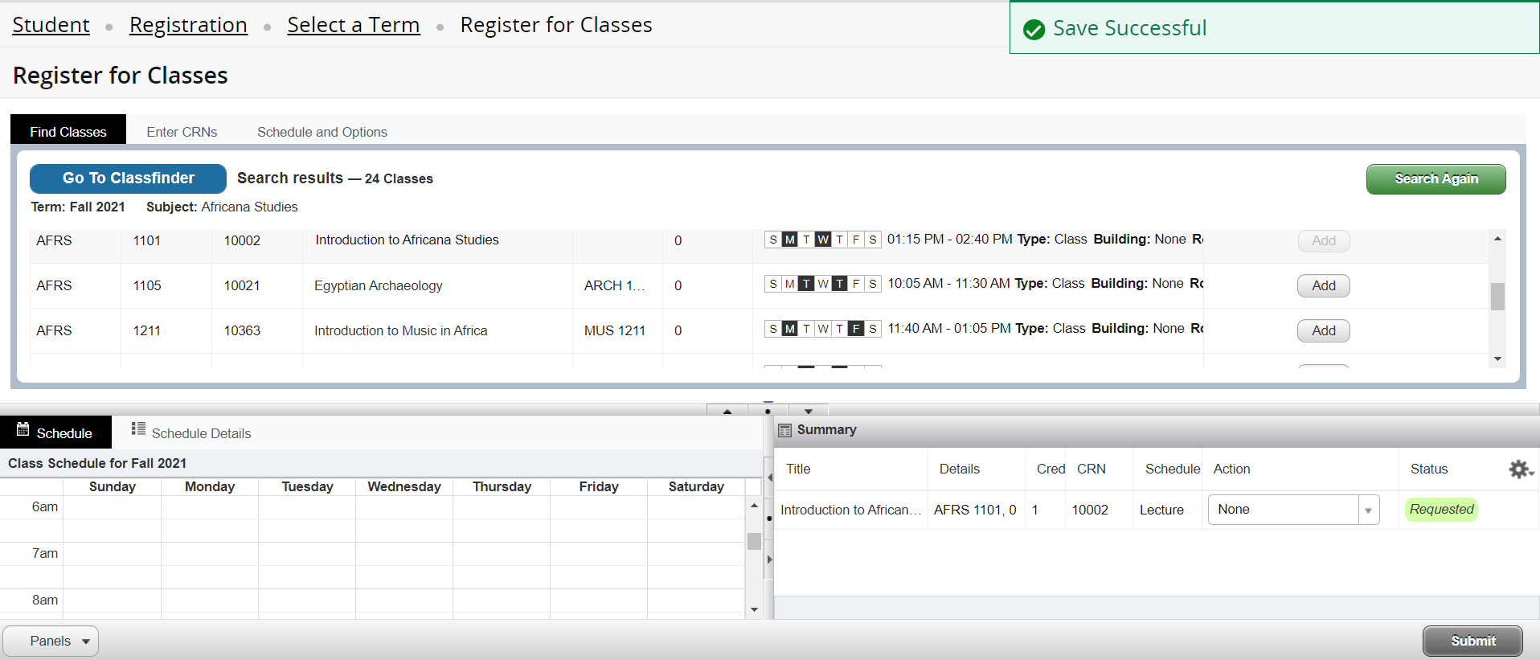
REGISTRATION The PROCESS: Requesting Classes
To request a course, choose the Add button, or enter a CRN on the “enter CRN” tab
CRNs can be added one at a time or all together.
Important exception: classes with required labs/sections must have both the “lecture” and “lab” CRN values entered in the same ”Add to Summary”.
After requests are made, be sure to click “SUBMIT”.

Slide 10
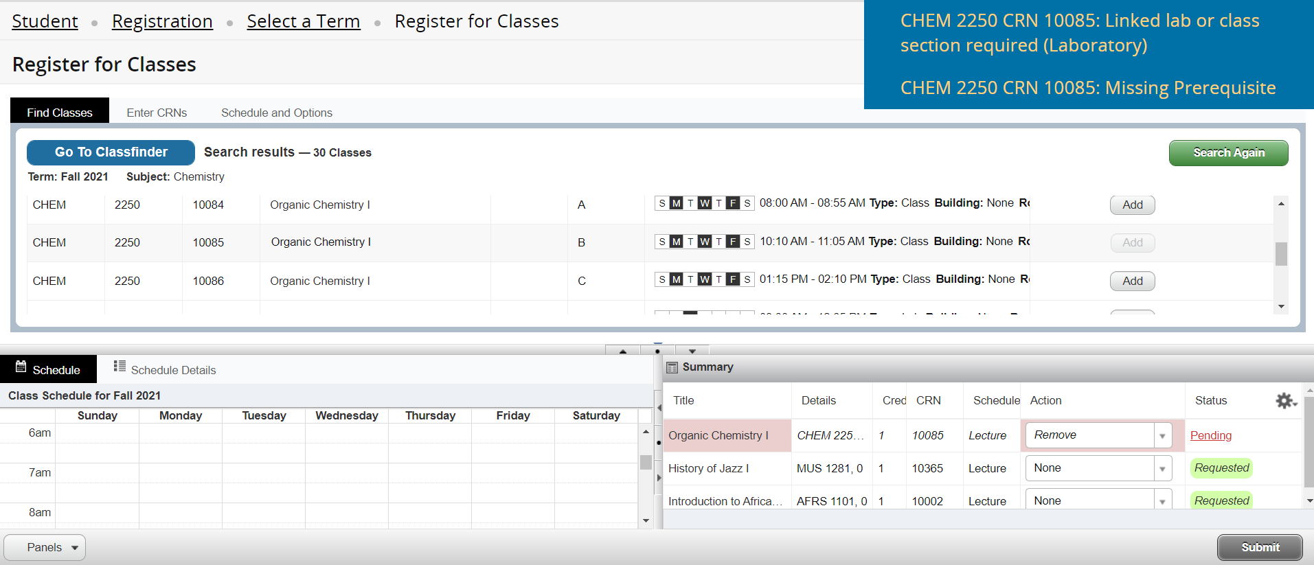
REGISTRATION The PROCESS: Requesting Classes
If you request a course that is not available to you due to a time conflict, a missing prerequisite, or other issue, you will see an error message.
You can remove this choice, or another choice in a request round by choosing “remove” and “submit”.
Once you are registered for a course in Rounds 1 and 2, you may not drop them until Add/Drop.

Slide 11
REGISTRATION The TIMELINE
Monday, August 30
Prepare for your individual meeting with your advisor by arriving with:
POTENTIAL COURSE SELECTIONS, INCLUDING FIRST YEAR WRITING SEMINARS
ALL HOLDS CLEARED, EXCEPT YOUR ADVISOR HOLD.
Your advisor will lift the advisor hold in Polaris to indicate approval of your course choices.
Your Enrollment Form hold will be lifted upon completion of your Enrollment Form; due by 5 pm.
Round 1 is NOT first-come, first – served. You will enter requests for courses into Polaris, and requests are processed at once. Putting your requests at the start or end of the round will not affect your registration.
Time | Event
9:15 – 9:45 am | Group Meetings with Advisors
10 – 11:30 am | Academic Fair…firm up your registration plans here!
12 – 5 pm | Meet with your advisor and request your Round 1 choices in Polaris; bring your laptop.

Slide 12
REGISTRATION The TIMELINE
Tuesday, August 31
Round 2 is NOT first-come, first–served. You will enter requests for courses into Polaris; you can’t drop anything in which you are registered. Requests are processed at once. Putting your requests at the start or end of the round will not affect your registration.
First-Year Add/Drop I is the only registration in your Bowdoin career that will be first-come, first–served.
Time | Event
7:30 am | Round 1 Results available in Polaris; you will also receive email
8:00 am – 12:00 pm | Round 2 requests made with your advisor in Polaris; this meeting is required, even if your schedule is set.
2:30 pm | Round 2 results in Polaris; you will also receive email
7:30 – 11:30 pm | First Year Add/Drop I; advisors available 7:00 – 8:00 pm

Slide 13
REGISTRATION The TIMELINE
Wednesday, September 1
Instructor Permission in Polaris is required to add any course ~
Students may drop without permission
A student can elect to take a course Credit/D/Fail at this point.
The Credit/D/Fail policy can be found in the Bowdoin College Catalogue and Academic Handbook – catalogue.bowdoin.edu
This option is discontinued on Wednesday, October 13th at 5 pm.
Time | Event
8:00 am | Classes begin!
9:00 am | All students eligible to participate in Add/Drop II (until Sept 15th at 5 pm)

Slide 14
REGISTRATION Process Considerations
FYWS courses are required for all First-Year students and should be taken in the fall.
These courses are like all others in the registration request process.
Use info available in Class Finder to be strategic about selecting highly requested courses.
After selecting “top choice” classes, identify a few alternative courses as back-ups ahead of time​
Attend the Academic Fair – talk to faculty, look at department handouts, ask questions about courses
Aim to complete distribution requirements in your first two years
(the point of declaring a major in the spring of sophomore year is that you have time to widely explore the curriculum)
Don’t panic if Round One doesn’t yield four courses – unexpected courses can lead to great discoveries!

Slide 15
Meeting your academic advisor:
Group meeting: Monday morning 9:15 at the advisor’s office – unless they ask you to meet elsewhere; check your Bowdoin e-mail tonight!
Individual meeting: Monday afternoon (scheduled at the morning group meeting)
If you did not fill out the ”Pre-Major Academic Advising Survey” earlier this summer, your advisor may ask you to complete a paper version before the afternoon meeting
Your advisor is your key point of contact with Bowdoin
They will offer to discuss your academic goals and interests, and help you to decide on the courses you will request during registration
You advisor can also point you to other resources on campus
Get ready with a list of course you are interested in, before meeting your advisor.

